Slide 1


Fast Subspace Fluid Simulation with a Temporally-Aware Basis
Siyuan Chen
Yixin Chen
Jonathan Panuelos
Otman Benchekroun
Yue Chang
Eitan Grinspun
Zhecheng Wang
Notes:
Hi, I’m Zhecheng Wang from the Dynamic Graphics Project at the University of Toronto.​
​
This is joint work with Siyuan (our first author, visiting from Shanghai Jiao Tong University back then) and the rest of our UofT team: Yixin, Jonathan, Otman, Changyue, and Eitan.​
​
Today, I’ll focus on the method behind our temporally-aware subspace fluid simulation, and Siyuan will close it with applications.

Slide 2

Simulations Are Beautiful, But…
Notes:
Modern fluid simulation schemes require a huge number of degrees of freedom to resolve fine detail—and as a result, they can be very slow.​
Look at this beautiful Rayleigh–Taylor instability, notice all the complex vortical structure interaction in resolution?
But, hold up, now, think about the spatial cost of storage, and time cost of solving Poisson equation for this beautiful simulation.

Slide 3
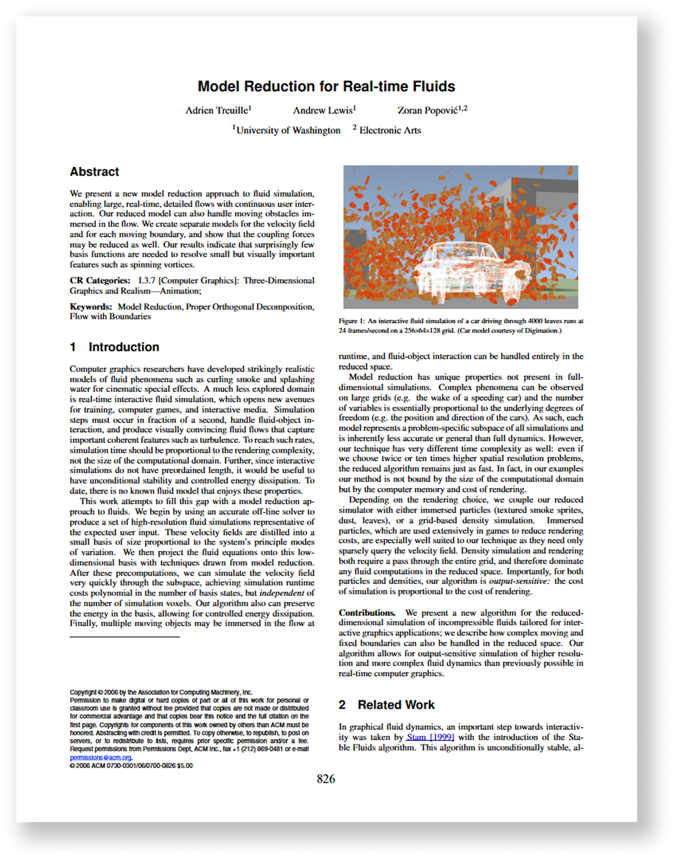
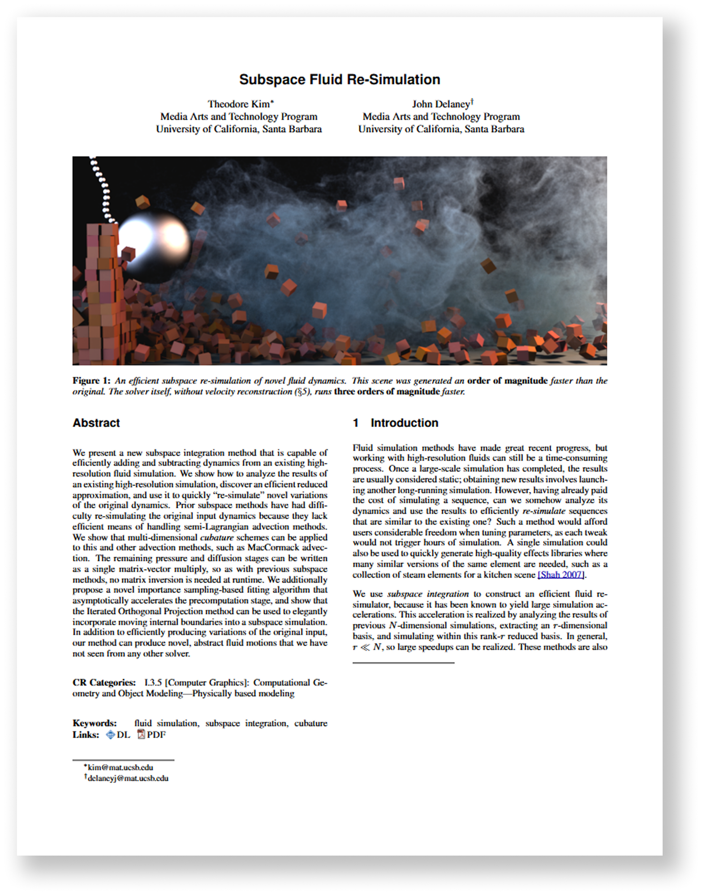
Previously on SIGGRAPH…
[Treuille et al. 2006]
[Kim and Delaney 2013]
Notes:
If you went to the Eigenanalysis course yesterday, you would learn that, oh, reduced order modelling would address this issue efficiently!
Here, these two papers are excellent examples of how to speed things up using reduced-order methods.​
They both construct a reduced space by applying Principal Component Analysis, on a dataset of fluid velocity fields, and then they solve a much smaller optimization problem in that reduced space to advect the fluid’s velocity state forward.​

Slide 4
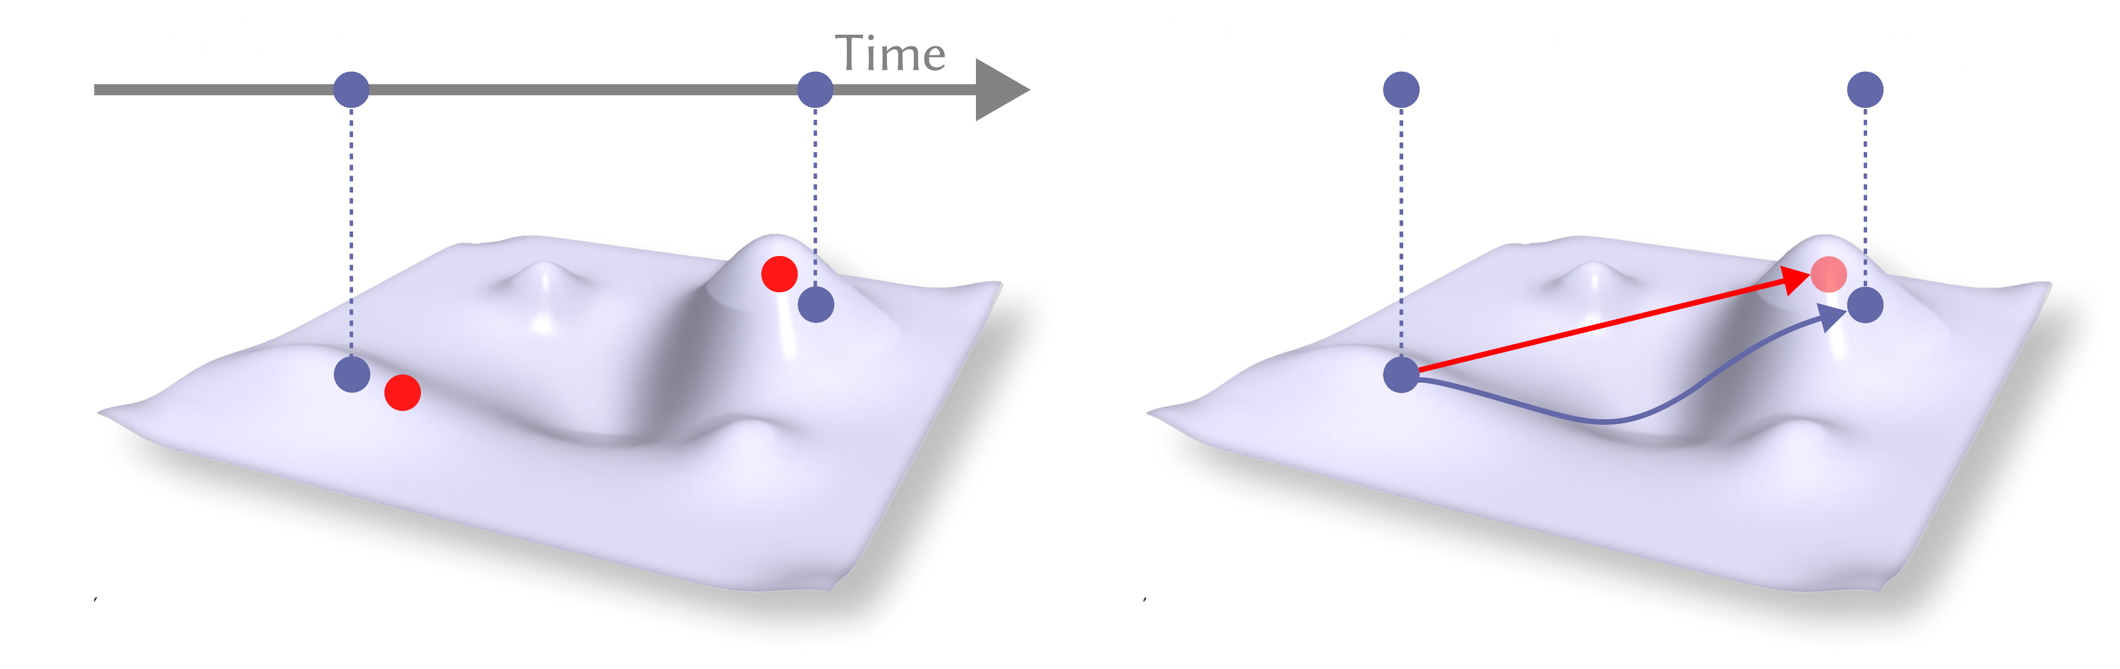
Model the Subspace
True Data Point
PCA Projection
PCA models a subspace of the solution space.
Notes:
How it works? PCA projects each snapshot onto a reduced manifold.​ ​
[CLICK] The dark blue dots represent the true data mapped to this manifold,
[CLICK] and the red dots are the projections or predictions.​
Notice there’s no connection between frames: PCA is data-order insensitive, it only minimizes reconstruction error for individual states.​

Slide 5

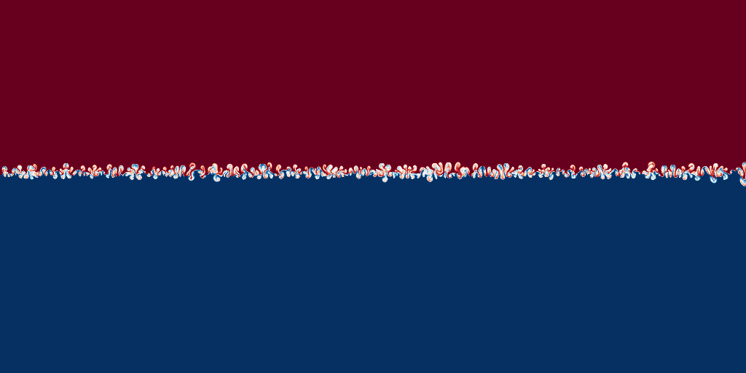
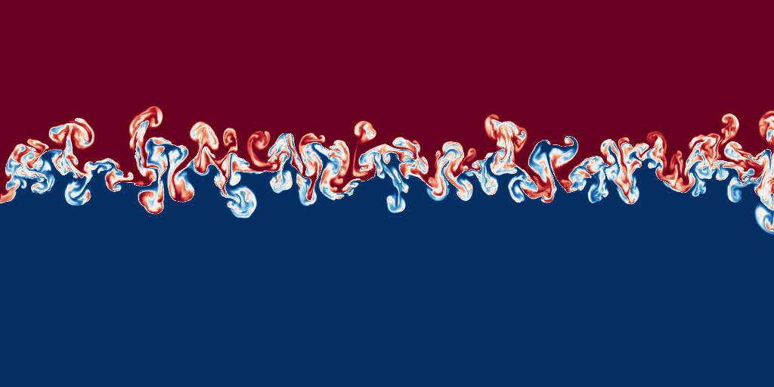
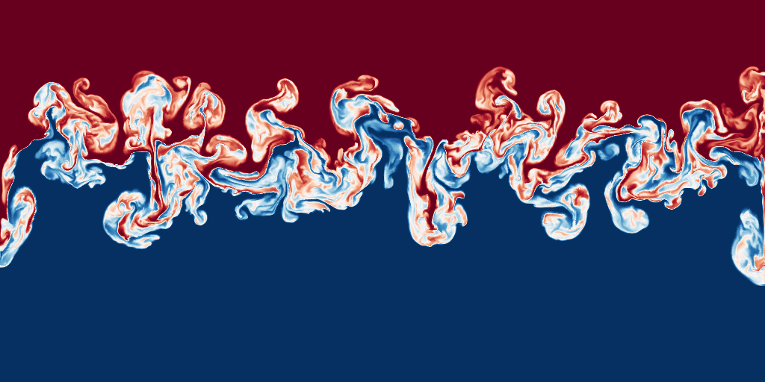
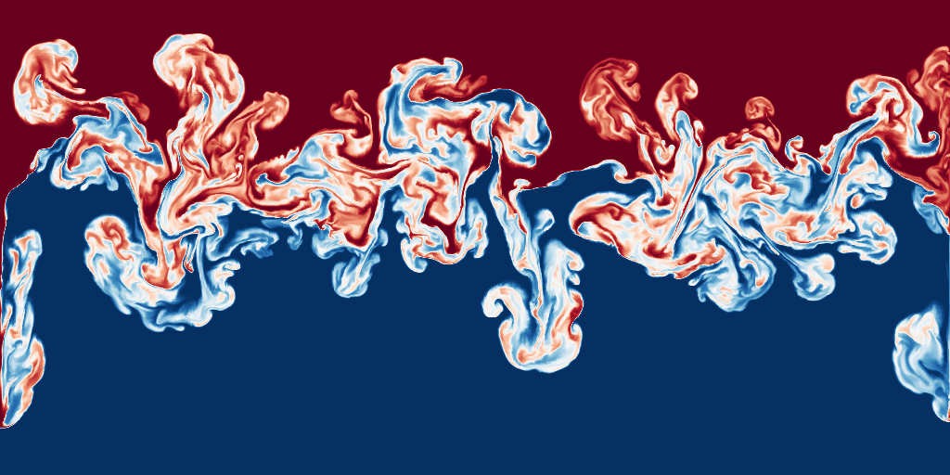
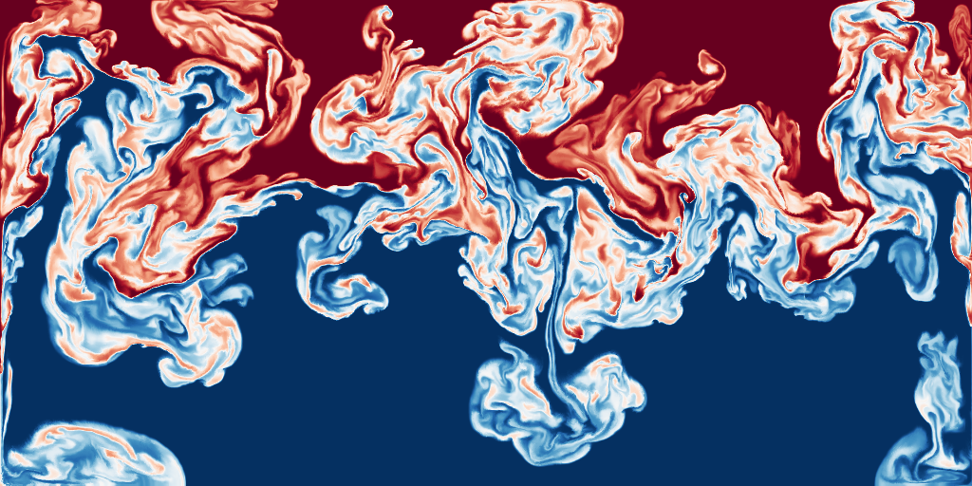
Model the Subspace
Snapshots
Notes:
So, standard Principal Component takes frames, or snapshops from the simulation roll out, frame by frame.
But wait, aren’t we forgetting about something? Do PCA really see the frames as we see it? [CLICK]

Slide 6
Model the Subspace
Snapshots
PCA: Order? What is that?
Notes:
Ohhhhhh, actually, Principal Component Analysis doesn’t see this order as we see it; it just compresses data based on variance, ignoring time.​
See this shuffled sequence? For PCA, it would have been numerically equivalent.

Slide 7
Data has Temporal Orders​
Time Evolution
Notes:
[CLICK] REMARK! Simulations in computer graphics are inherently temporal.​
Each frame depends on the previous one—the ordering carries information about how the system evolves.​
​
So, intuitively, we would LOVE to take advantage of this temporal structure. How about… let’s model the operator itself, that maps a state into the next? [CLICK]

Slide 8
Model the Operator
Dynamic Model Decomposition
Notes:
So today, we are going to talk about Dynamic Model Decomposition, DMD!

Slide 9
Model the Operator
DMD Approximation
True Evolution
DMD models the operator that maps a state to the next an objective that naturally requires temporal information.
Notes:
DMD takes a different view.
​
[CLICK] We know that the state at one instance of time must go to the next step in time subject to some energy constraint – see the dark blue line on the configuration manifold.
​[CLICK] Therefore, DMD doesn’t just model the state—it models the operator that maps one state to the next, approximated with a linear matrix, shown as the red arrow on the diagram.​
​
This naturally makes it data-order sensitive because it captures the temporal relationship between snapshots rather than treating them independently.​
​
While this makes sense, how do we actually approximate the operator?

Slide 10

System
The PDE of all spatial-temporal system can be described as:
$$\frac{∂u\left(x, t\right)}{∂t} =f\left(u\left(x, t\right), ∇u\left(x, t\right), ∇^{2}u\left(x, t\right),⋯, x, t\right)$$
Notes:
So let’s go back to the generalization of the system. The PDE of any spatial-temporal system can be written in this form.​

Slide 11

System
The PDE of all spatial-temporal system can be described as:
spatial-temporal
$$\frac{∂u\left(x, t\right)}{∂t} =f\left(u\left(x, t\right), ∇u\left(x, t\right), ∇^{2}u\left(x, t\right),⋯, x, t\right)$$
Notes:
Here, x represents the spatial variable.​ t is time, controlling the evolution of the system.​

Slide 12
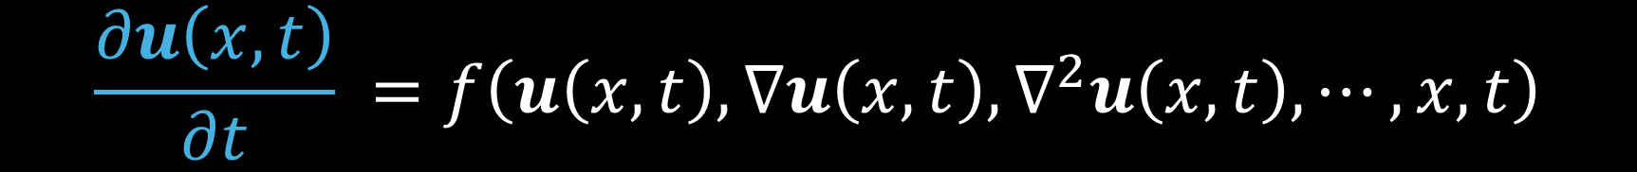
System
The PDE of all spatial-temporal system can be described as:
spatial-temporal
$$\frac{∂u\left(x, t\right)}{∂t} =f\left(u\left(x, t\right), ∇u\left(x, t\right), ∇^{2}u\left(x, t\right),⋯, x, t\right)$$
temporal evolution
Notes:
This derivative, the left hand side, is the temporal evolution of the state.​

Slide 13
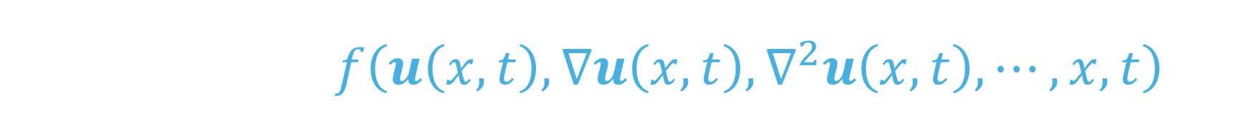
System
The PDE of all spatial-temporal system can be described as:
spatial-temporal
$$\frac{∂u\left(x, t\right)}{∂t} =f\left(u\left(x, t\right), ∇u\left(x, t\right), ∇^{2}u\left(x, t\right),⋯, x, t\right)$$
temporal evolution
dynamics / forcing term / spatial operator
Notes:
The right hand side, is what we call the dynamics of the system.

Slide 14


Model the Operator
$$\frac{du}{dt}=f(u)$$
Koopman Theory
$$u(t)=К_{t}u_{0}$$
infinite-dimensional nonlinear operator
infinite-dimensional linear operator
Notes:
We start with a nonlinear system where the state evolves under some function f(u). Instead of tracking the state directly, we look at a function of the state—let’s just pick the identity function: g(u) = u.
[CLICK] Koopman theory tells us that in this lifted space, the evolution becomes linear. [CLICK] So we get a linear operator Kₜ that evolves the state: “remember, the right equation is STILL EXACT, just rewritten to live in an infinite-dimensional space.”

Slide 15


Model the Operator
Discretization
$$u(t)=К_{t}u_{0}$$
$$u(t)=Ku_{0}$$
infinite-dimensional linear operator
finite-dimensional linear operator
Notes:
But despite it is linear, we still can’t work with an infinite-dimensional operator in practice. [CLICK] But since we’re observing the state on a grid, we can discretize the operator into a finite matrix. [CLICK] Discretization gives us a finite-dimensional linear operator K on the right that acts on the grid values, still evolving the state forward in time.

Slide 16









Approximate the Operator
$$T$$
Frames
Data Matrix
Frame 0 to Frame T-1
$$X=[u\left(0\right) u\left(1\right) u\left(2\right) ··· u(T−1)]$$
$$K$$
$$K$$
$$K$$
$$K$$
$$\tilde{K}$$
$$\tilde{K}$$
$$\tilde{K}$$
$$\tilde{K}$$
$$X′=[u\left(1\right) u\left(2\right) u\left(3\right) ··· u(T)]$$
Time-shifted
Data Matrix
Frame 1 to Frame T
$$T$$
Frames
Notes:
Now, let’s COMPUTE the K operator just now.
[CLICK] For a data sequence of frame 0 to frame T.
We construct data matrix X go from frame 0 to frame T-1.
[CLICK] Then we shift the entire sequence by one frame, constructing X frame, from frame 1 to frame T.
[CLICK] Therefore, we could align X with X prime, essentially asking the question, [CLICK] can we map frame 0 to frame 1 with a linear operator K? Can we map frame 1 to frame 2 with a linear operator K? For all aligned columns in the data matrix X and the TIME-SHIFTED data matrix X prime.
[CLICK] But, K is a full space operator, it is massive as it is # of DoF by # of DoF, so we have to approximate, AKA the K tilde operator. [CLICK]

Slide 17





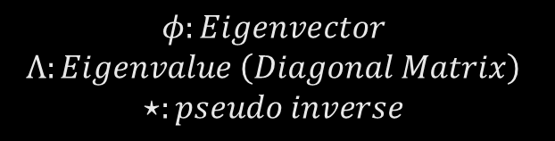
Approximate the Operator
$$T$$
Frames
$$X≈UΣV^{T}$$
Singular Value Decomposition
Low-rank Approximation of Data
$$X=[u\left(0\right) u\left(1\right) u\left(2\right) ··· u(T−1)]$$
N DoFs
$$\tilde{K}≈X^{′}VΣ^{−1}U^{T}$$
$$\tilde{K}X≈X^{′}$$
Solve for Full-space Approximated Operator
$$\tilde{K}=Φ^{⋆}ΛΦ$$
Eigen Decomposition
$$φ:Eigenvector$$
$$Λ:Eigenvalue \left(Diagonal Matrix\right)$$
$$⋆:pseudo inverse$$
Notes:
[CLICK] Apparently, K just now is a massive matrix, given X is MASSIVE — it has N rows for each degree of freedom and T columns for each time step — so solving directly would be expensive.
[CLICK] So, instead, we run a low-rank SVD on X to find the dominant structure in the data.
[CLICK] We know that K tilde maps X to X prime. So if we run a low-rank approximation of X, we could use the singular vectors and singular values to [CLICK] replace, approximate X, plugging that into the equation, we could get the solution for K tilde, the approximated operator. [CLICK] Lastly, with some linear algebra magic we omit here, we go into the reduced space and go back to the full space to get the eigenvectors Phi and the eigenvalues Lambda with eigen decomposition for the approximate operator, the SQUARE matrix K tilde. Those values will come in handy later in applications!

Slide 18
Baselines
Validation and Comparison.
Notes:
Next, let’s welcome Siyuan, he will talk about the baselines and evaluation of DMD.
Hi, I’m Siyuan, let’s start with the baselines and evaluation to see how good DMD is when put under stress.

Slide 19
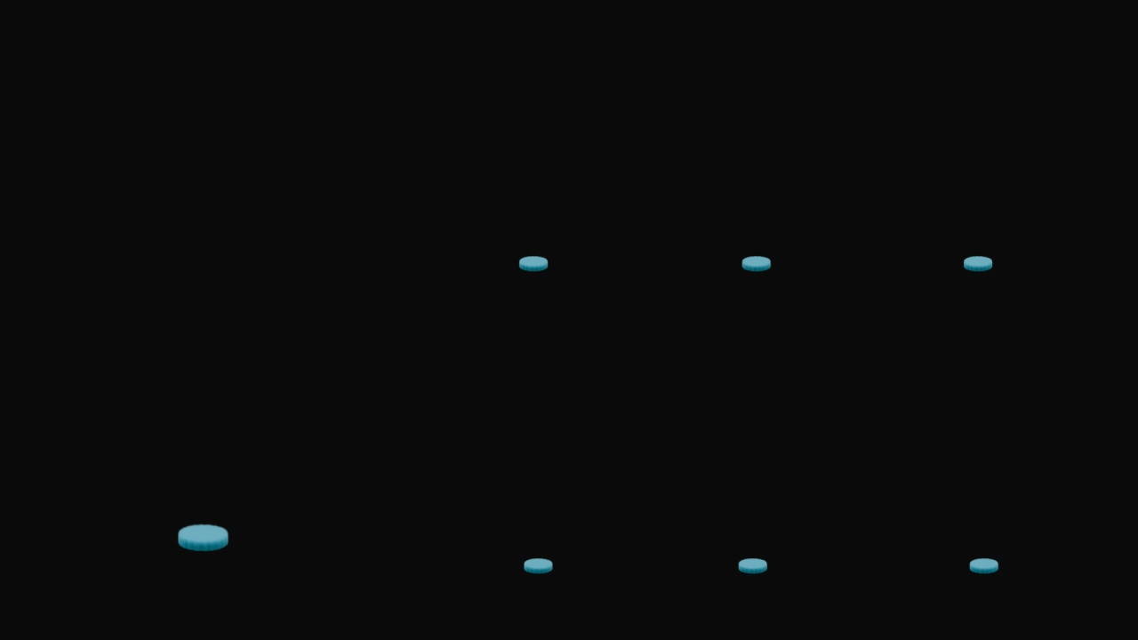
Reconstruction
r=2
RMSE=3.6%
r=9
RMSE=2.6%
r=28
RMSE=1.7%
Ground Truth
r=61
RMSE=0.9%
r=105
RMSE=0.4%
r=130
RMSE=0.3%
Notes:
Let’s start with a simple test: a standalone plume. We run DMD at different ranks and see how well it can reconstruct the simulation. At low ranks, we lose some detail—but by the time we hit rank 61 [CLICK] , the reconstruction looks almost identical to the ground truth.

Slide 20
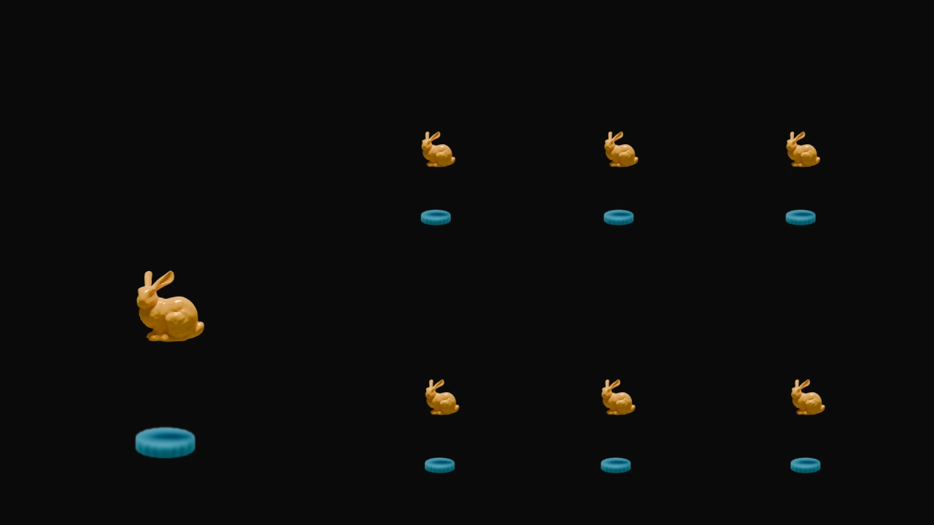
Reconstruction: Bunny
r=2
RMSE=2.5%
r=9
RMSE=1.8%
r=28
RMSE=1.1%
Ground Truth
r=61
RMSE=0.4%
r=105
RMSE=0.2%
r=130
RMSE=0.1%
Notes:
Let’s start with a simple and standard test: a plume running into a bunny. We run DMD at different ranks and see how well it can reconstruct the simulation. At low ranks, we lose some detail—but by the time we hit rank 61 [CLICK] , the reconstruction looks almost identical to the ground truth.

Slide 21
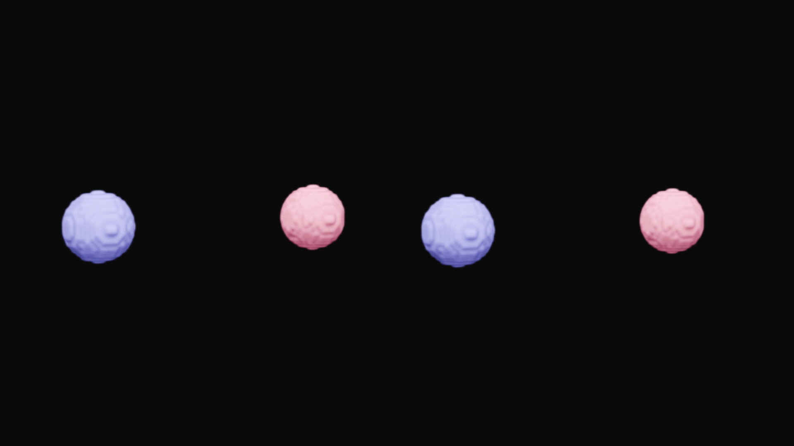
Reconstruction: Ring Collision
Ground Truth
Ours
r=150
Notes:
So, what about scaling?
Here, we show a 3D example on a 128x256x256 grid, the complex vortex structure of vortex ring collision is well-captured by DMD with 150 basis.

Slide 22


Comparison
[Kim and Delaney 2013]
r=61
Ground Truth
Ours
r=61
Notes:
Now let’s compare DMD to something more traditional—PCA. We use the same rank—61—for both methods.

Slide 23
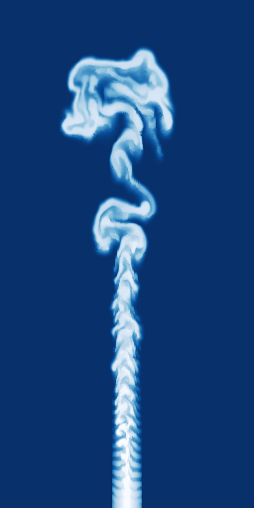
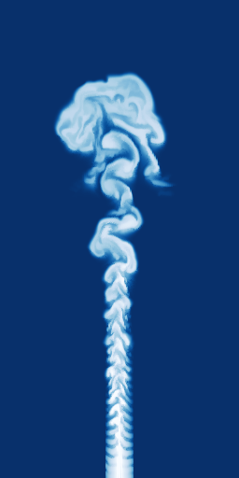
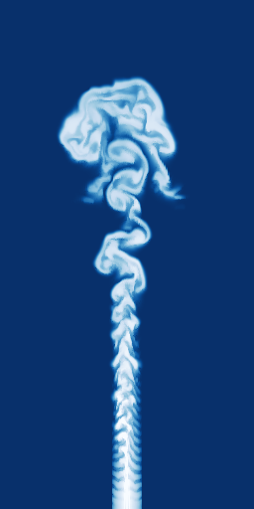
Comparison
794×
Precompute: 114s
84179×
Precompute: 79s
[Kim and Delaney 2013]
r=61
Ground Truth
Ours
r=61
Notes:
PCA-based approach does okay on the big picture, but look closely at the upper boundary at the end.
We can see that, [CLICK] DMD preserves the fine vortex structures, while PCA-based approach adds artifacts and distort key features.
So even though both compress the data, DMD keeps more of the important physics.
[CLICK], thanks to the temporal part also being modelled as a simple matrix multiplication, we no longer need to solve mini optimization problem in reduced space, therefore DMD get a massive speed-up compared to PCA

Slide 24
Applications
One operator to rule them all.
Notes:
Next section, we are going to discuss the applications of DMD.
Because our reduced space is temporally aware, it naturally opens up NEW CAPABILITIES.

Slide 25








Application: Fast Integration
$$u_{i+1}≈{\tilde{K}u}_{i}$$
$$u_{i+2}≈\tilde{K}u_{i+1}$$
$$u_{i+3}≈{\tilde{K}}^{3}u_{i}$$
$$u_{i+n}≈{\tilde{K}}^{n}u_{i}$$
$$u_{i+1}≈{\tilde{K}}^{1}u_{i}$$
$$u_{i+2}≈{\tilde{K}}^{2}u_{i}$$
$$u_{i+3}≈\tilde{K}u_{i+2}$$
…
$$u_{i+n}≈\tilde{K}u_{i+n−1}$$
Notes:
First, let’s start with fast integration. Once we’ve trained the DMD operator, [CLICK] we can use it to predict future states directly. Because it’s linear, [CLICK] [CLICK] we can raise the operator to high powers. [CLICK]

Slide 26
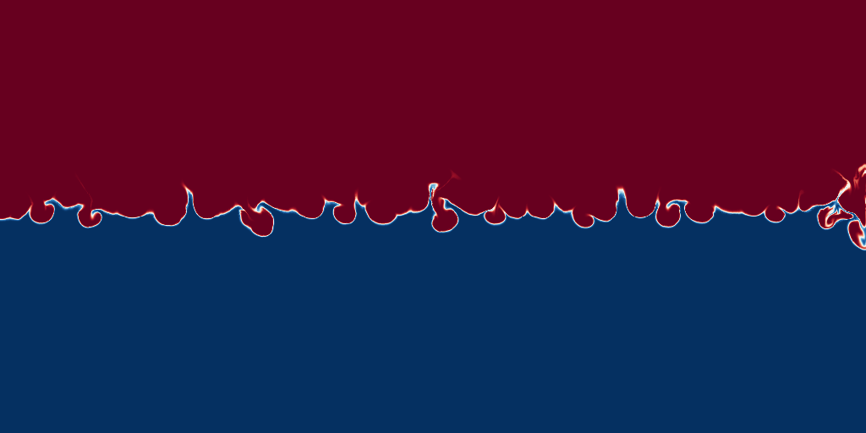
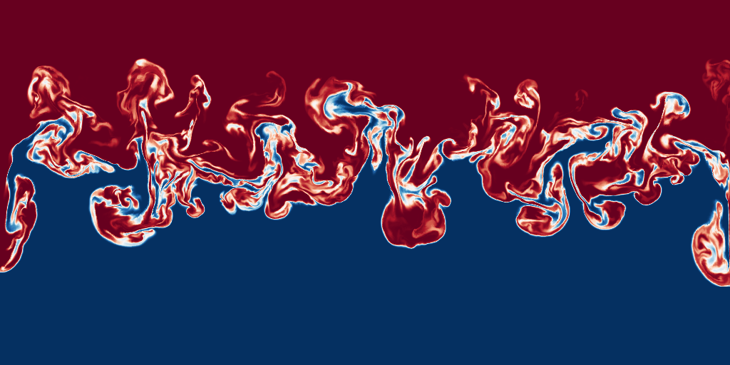
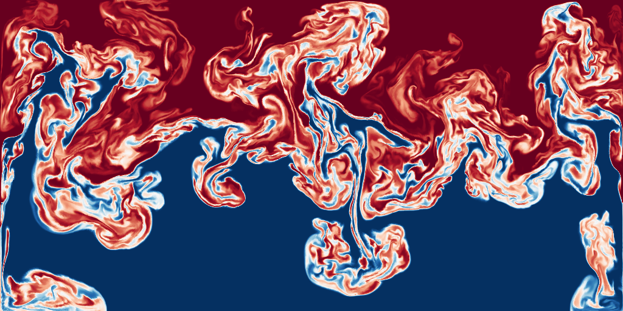
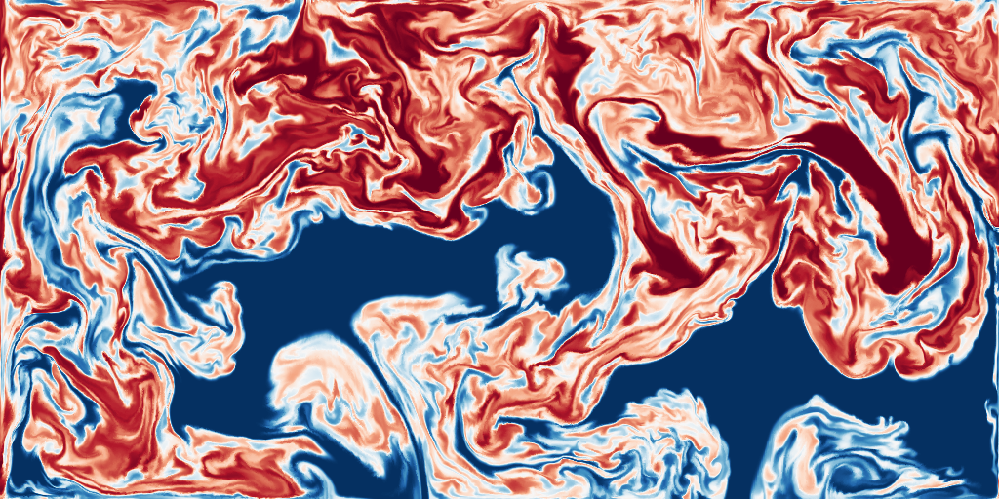
Application: Fast Integration
t=120
t=180
t=300
t=180
t=240
t=300
t=240
Jump 120 Frames
Jump 180 Frames
Integer Power = Discrete-time
Jump 60 Frames
Fractional Power = Continuous-time
Notes:
Let’s revisit the Rayleigh-Taylor example. Start with frame 120, if we were to proceed with a traditional method, we have to timestep FRAME BY FRAME to 121, 122, etc
But since the temporal dynamics is simply modelled as a matrix exponential, we could jump forward in time by applying the appropriate power. [CLICK] That means we can instantly go from frame 120 to frame 150, frame 180, or ANY arbitrary frame in the future.
[CLICK] We can even go to any CONTINUOUS time in the future by raising a FRACTIONAL power. [CLICK]

Slide 27

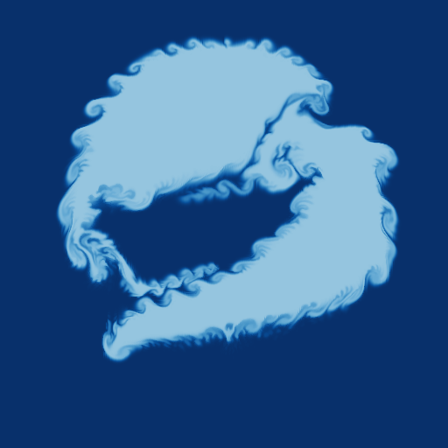
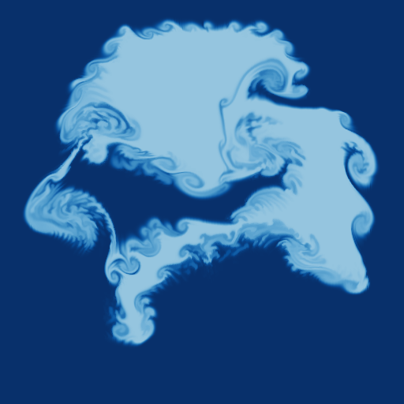
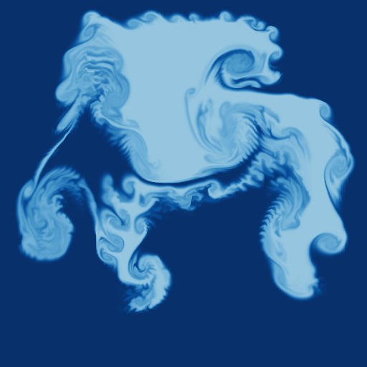





Application: Reversibility
Forward Prediction
$$Λ$$
$$Λ$$
$$Λ$$
$$Λ^{−1}$$
$$Λ^{−1}$$
$$Λ^{−1}$$
Backward Retrodiction
Notes:
Next up, applications in time reversal. [CLICK] DMD gives us a linear operator that maps one frame to the next. And because it’s linear, it’s also invertible.
Moreso, once you have the SVD, this inverse is trivial as the reciprocal of the diagonal eigenvalue matrix. That means we can FLIP the operator [CLICK] —and use it to go BACKWARDS in time.
So given the forward data, [CLICK] we can invert the linear operator, and reconstruct past states from the last frame. We’re essentially “REWINDING” the system—frame by frame. And because DMD learns the actual dynamics, the reversed flow still looks physically valid.

Slide 28
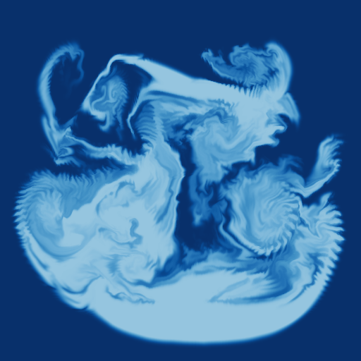


Application: Reversibility
Forward Prediction
$$Λ$$
$$Λ$$
$$Λ$$
$$Λ^{−1}$$
$$Λ^{−1}$$
$$Λ^{−1}$$
$$Λ^{−1}$$
$$Λ^{−1}$$
$$Λ^{−1}$$
Unseen Retrodiction
Backward Retrodiction
Notes:
[CLICK] This lets us predict frames at t = –1, –2, –3, and so on. No special data needed—just INVERT the forward operator and apply it.

Slide 29
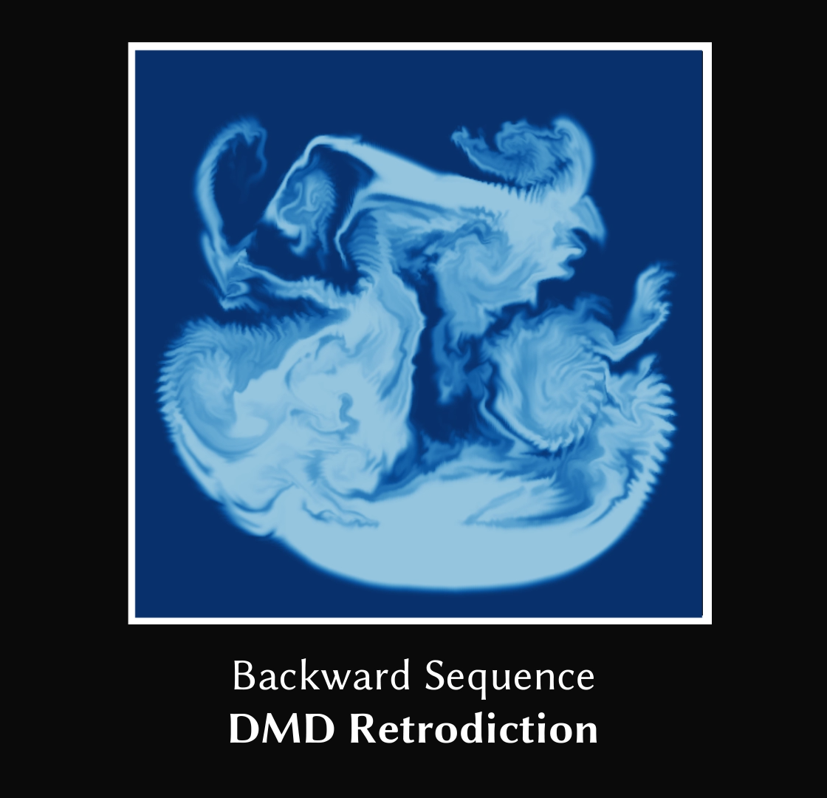
Application: Reversibility
Notes:
And we can go big with this. Train on data on positive time, then reverse it backwards in time. Now we have the full timeline—time retrodiction to prediction.

Slide 30
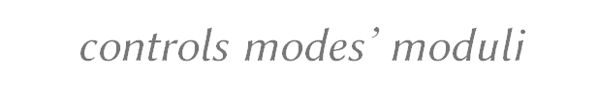
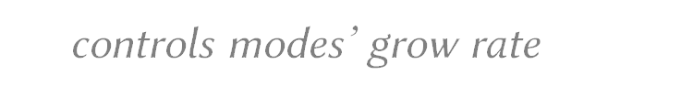

Application: Direct Editing Temporal Dynamics
$u\left(t_{0}+kΔt\right)=$ $\sum_{i=1}^{n}{w_{i}Φ_{i}r_{i}^{k}(\cos\left(kθ_{i}\right)+\sin\left(kθ_{i}\right)z_{i}(t_{0})}$
$w$ controls modes’ moduli
$r$ controls modes’ grow rate
$θ$ controls modes’ frequency
Notes:
The third application is direct editing via the complex eigenvalues. The trained operator also lets us edit the flow. [CLICK] DMD breaks the system into interpretable modes—each with an amplitude [CLICK], growth rate [CLICK], and frequency [CLICK]. So we can tweak those parameters directly to modify the behavior. We can amplify or suppress structures, slow things down, or change how fast it oscillates.

Slide 31
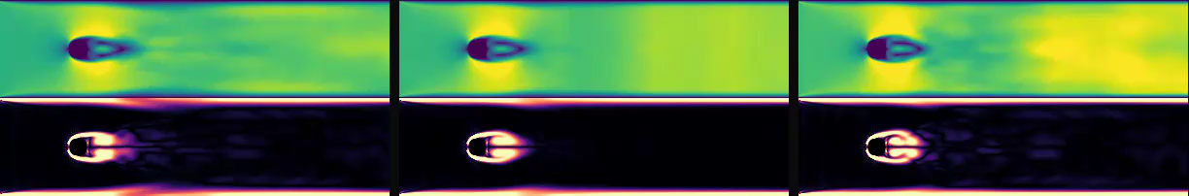
Application: Direct Editing Temporal Dynamics
Modulus editing with multipliers 0.5, 1.0 and 1.5:
x0.5
x1.0
x1.5
$u\left(t_{0}+kΔt\right)=$ $\sum_{i=1}^{n}{w_{i}Φ_{i}r_{i}^{k}(\cos\left(kθ_{i}\right)+\sin\left(kθ_{i}\right)z_{i}(t_{0})}$
Notes:
Here’s an example using a Kármán vortex street. We start by training the operator on a baseline dataset. Then we scale all the mode amplitudes—down by 50% on the left, and up by 50% on the right. What happens? We get a softer or stronger wake—without breaking the flow structure.
The same thing can be applied to the real and imaginary component of the eigenvalue, and we can get faster or slower, more vortical or less vortical sequence.

Slide 32
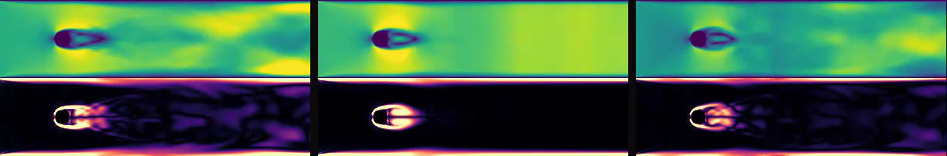
Application: Direct Editing Temporal Dynamics
Real-component editing with multipliers 0.5, 1.0 and 1.5:
x0.5
x1.0
x1.5
$u\left(t_{0}+kΔt\right)=$ $\sum_{i=1}^{n}{w_{i}Φ_{i}r_{i}^{k}(\cos\left(kθ_{i}\right)+\sin\left(kθ_{i}\right)z_{i}\left(t_{0}\right)}$
Notes:
Next, we play with growth rates. Cut them to 50% on the left—and the vorticity grows more slowly. Boost them by 50% on the right—and it grows faster.

Slide 33
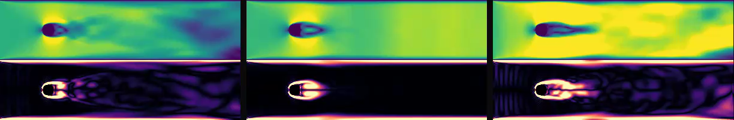
Application: Direct Editing Temporal Dynamics
Imaginary-component editing with multipliers 0.5, 1.0 and 1.5:
x0.5
x1.0
x1.5
$u\left(t_{0}+kΔt\right)=$ $\sum_{i=1}^{n}{w_{i}Φ_{i}r_{i}^{k}(\cos\left(kθ_{i}\right)+\sin\left(kθ_{i}\right)z_{i}(t_{0}) }$
Notes:
Same idea with frequency. Cut the frequencies in half on the left—you get a slow-motion version. Boost them by 50% on the right—you get time compression. And again, the flow stays coherent—just faster or slower depending on the tweak.

Slide 34





Application: Upsampling
High-frequency
Initial Eigenvalues
$$\tilde{K}=Φ^{T}ΛΦ$$
High-resolution Static
Input Initial Condition
Low-frequency
Eigenvalues Sequence
High-resolution
Training Dynamics
High-resolution
Upsampled Dynamics
Low-resolution
Input Dynamics
Notes:
We end this presentation with one last application: upsampling.
Let’s say we only have a low-frequency sequence, but we’d really like to get those sharp, high-frequency details back. Here’s what we do: [CLICK] we grab a DMD model that was trained on high-frequency data. [CLICK] Then we apply it to a high-res version of the first frame — just kind of kick-start the process. [CLICK] After that, for every new frame, we keep updating using the structure from the low-frequency sequence.

Slide 35



Application: Upsampling
$$512×512$$
Resolution
High-resolution Static
Input Initial Condition
$$512×512×300$$
Resolution Frames
$$64×64×300$$
Resolution Frames
High-resolution
Upsampled Dynamics
Low-resolution
Input Dynamics
Notes:
Here’s an example. The high-frequency operator was trained on circular density fields. The low-frequency dataset? A very low resolution SIGGRAPH LOGO. We use our method—and boom: we recover fine vortex structure and sharp interfaces that weren’t in the original low-res data.

Slide 36
Summary
Modeling operator vs. Modeling solution space
Fast and high-quality reconstruction
Downstream applications taking advantage of the linearity of the temporal operator
Notes:
To wrap it up: [CLICK] Our approach is operator-centric—not just about predicting solutions, but modeling the system itself. [CLICK] That gives us better performance, better fidelity, and more flexibility. [CLICK] And because the operator is interpretable, invertible, and editable, it opens up a ton of applications: All made possible by DMD.

Slide 37

Thank you!
Siyuan Chen
Yixin Chen
Jonathan Panuelos
Otman Benchekroun
Yue Chang
Eitan Grinspun
Zhecheng Wang
Link to Project Page!
Take a photo now or,
Come talk to us later
Notes:
Thanks for listening!
If you are interested, please take a photo of the QR code now or come talk to us in poster session – the QR code will take you to the project page.

